Slide 1
SWAN Quarterly Meeting
June 2, 2022

Slide 2
Agenda
Call to Order and Welcome
Public Comment
Introduction of New Library Directors
2022 SWAN Board Election results
Library performance metrics: a comparison against 2019 data
Library cards for nonresidents
Birds of a Feather: SWAN Community Forums update
SWAN Training & Learning Management System
SWAN “Libraries Empower Connection” (Passport) Idea
Announcements & Questions

Slide 3
Board Election 2022

Slide 4
Board election update
Election Results: 3-year term 2022-2025
Jesse Blazek, Palos Heights Public Library
Colleen Waltman, Homewood Public Library
Anna Wassenaar, Blue Island Public Library
Special thanks to Dorothy Koll, Acorn Public Library District & Lisa Knasiak, Chicago Heights Public Library
Next board meeting: June 17th 9:30am at Bloomingdale Public Library

Slide 5
Library performance metrics

Slide 6
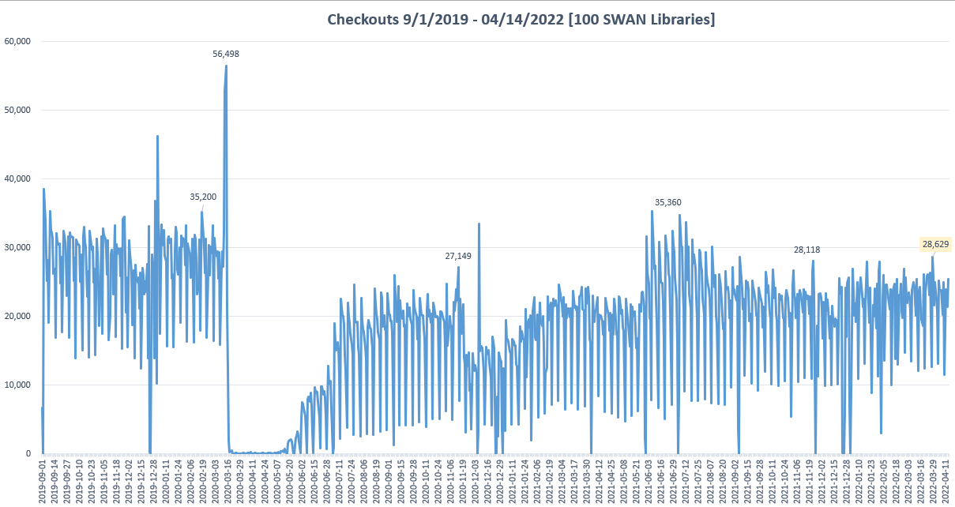

Slide 7
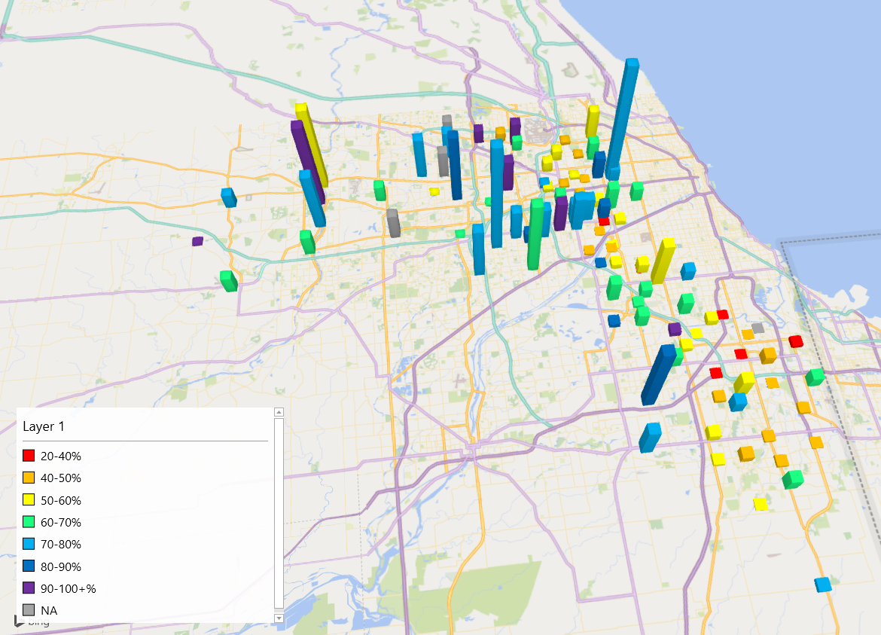

Slide 8
Circulation comparison across time
Shared Reports > SWAN Objects > SWAN Dossier Reports > Checkout Comparison Pre-COVID, Current > Circulation Comparison – COVID Impact
Based on composite SWAN reporting we provide in Board monthly reports.
Combines all branches, pseudo library activity for your library.
Can be used to compare your library’s activity, as well as review other libraries nearby.
Select the years you wish to compare.
You can ignore library to select all, and then filter to your library.
For faster processing, you can select your library only.

Slide 9
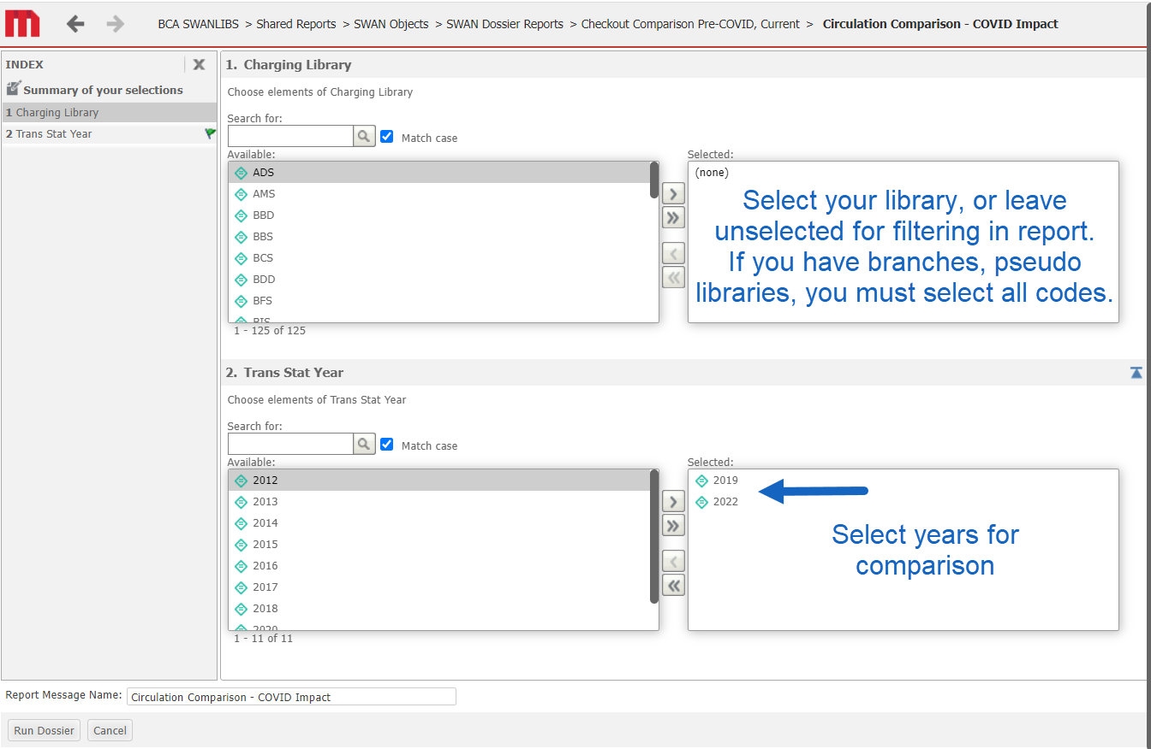

Slide 10
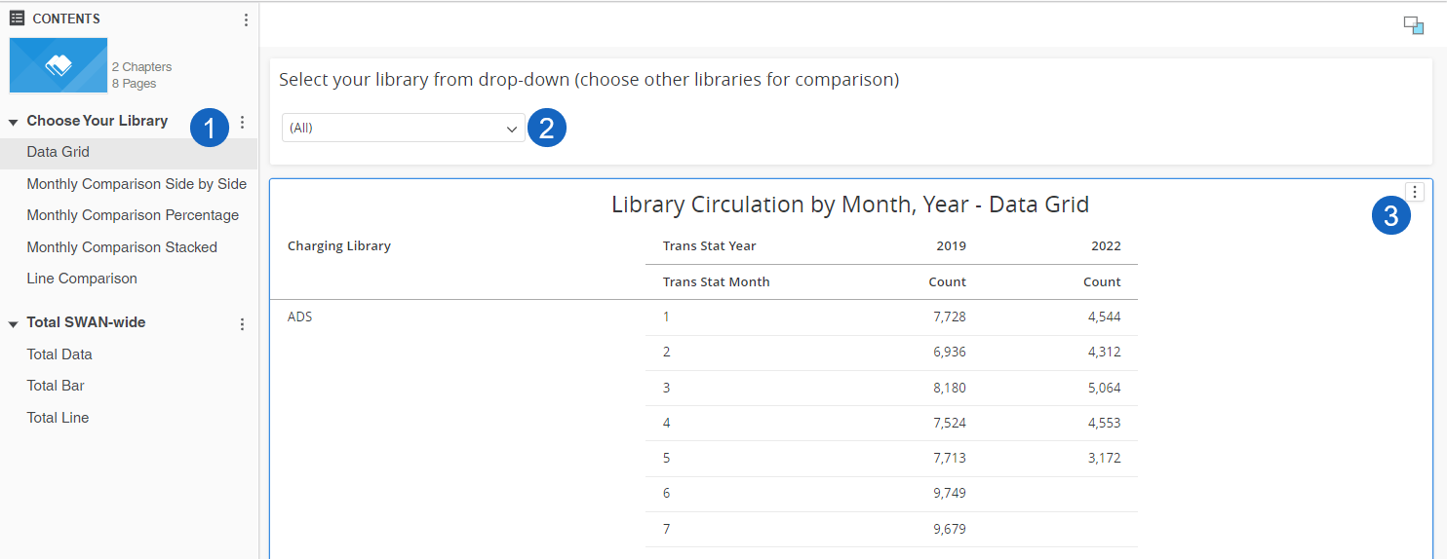
Choose view, filter, download
Select view/page in chapter
Filter to your library
Download data, if desired for analysis outside of BcAnalytics

Slide 11
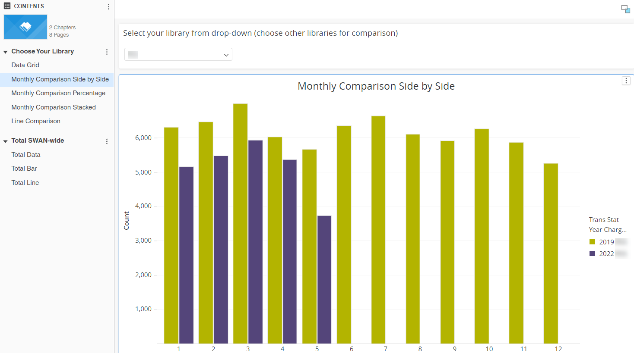
Monthly Comparison Side by Side

Slide 12
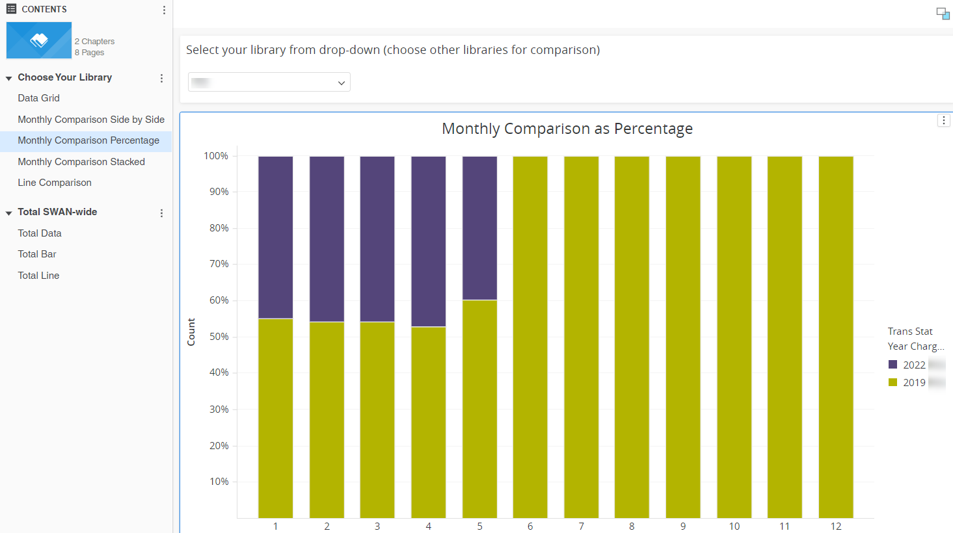
Monthly Comparison Percentage

Slide 13
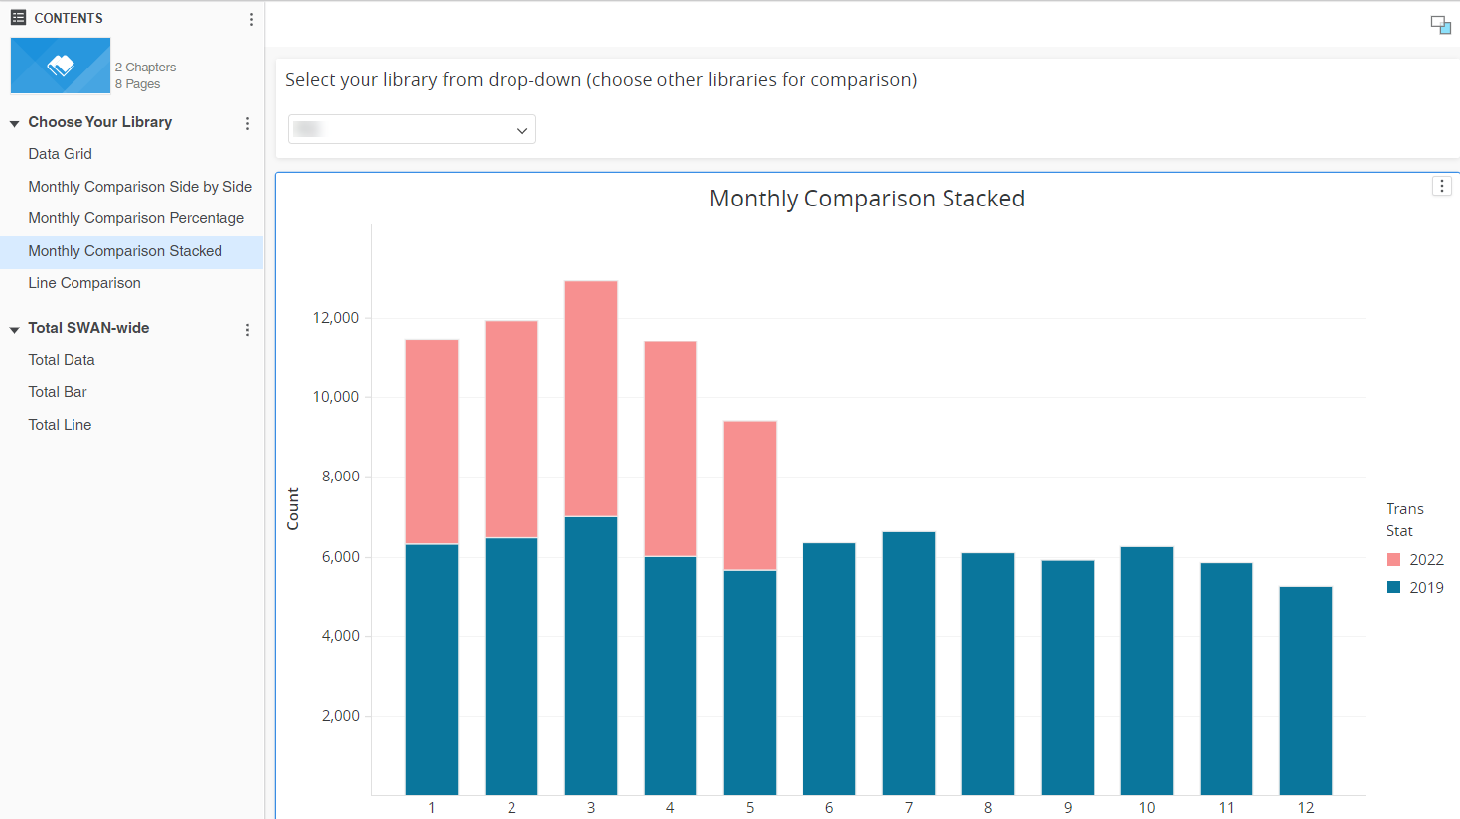
Monthly Comparison Stacked

Slide 14
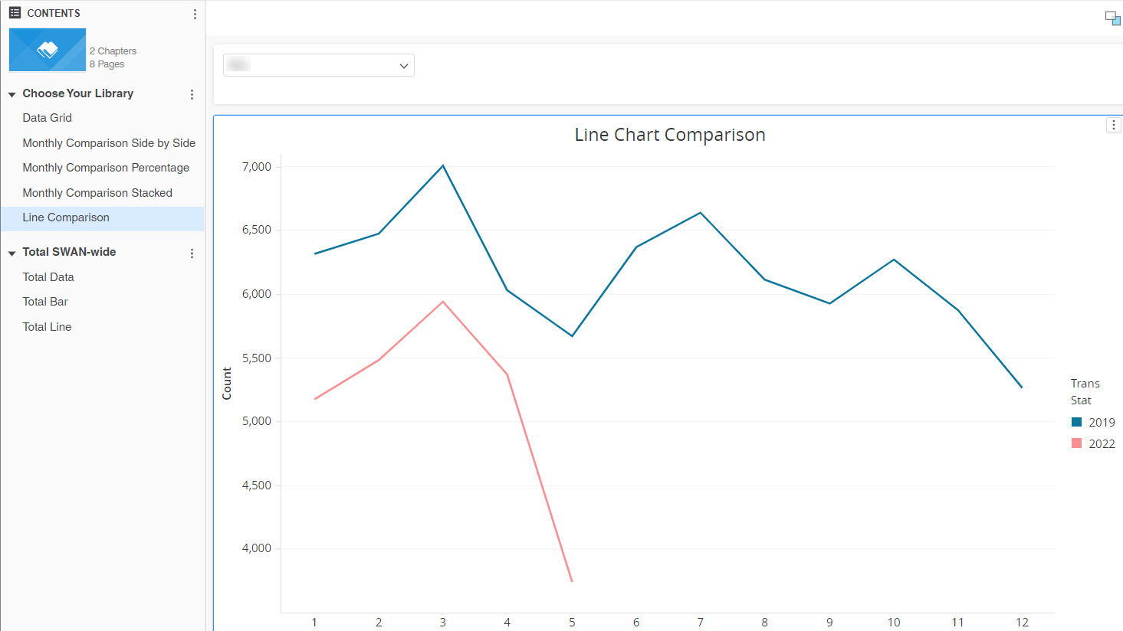
Monthly Line Comparison

Slide 15
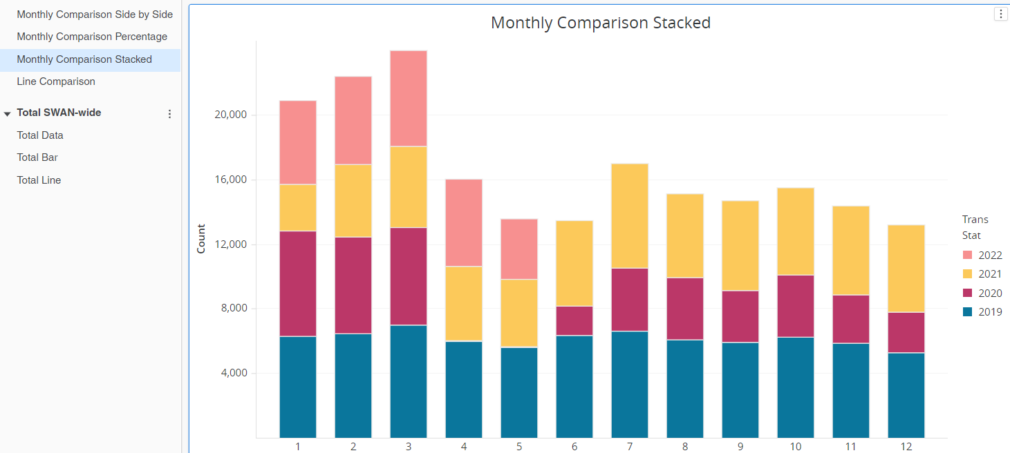
More years, more data – longer to process
Do Directors want a targeted webinar featuring this dossier?

Slide 16
Library cards for nonresidents

Slide 17
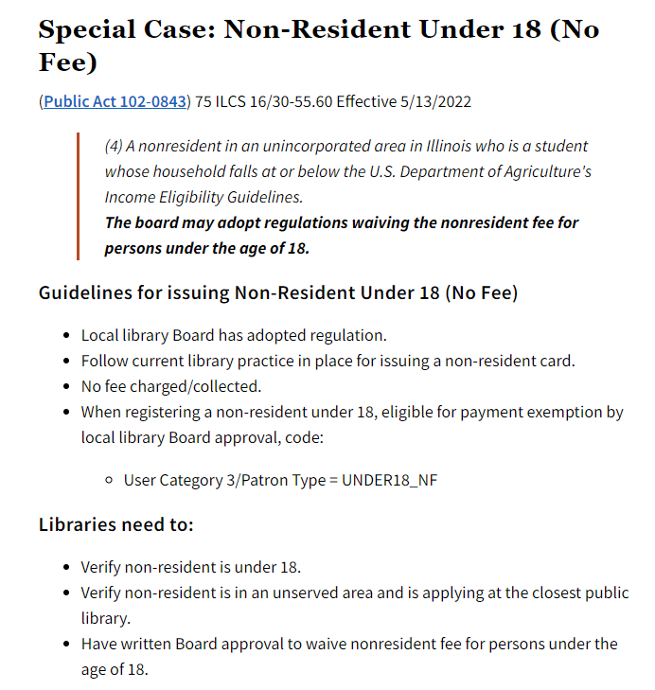
SB3497 5/13/2022
Library Board must approve waiver (local library decision)
If approved locally,
  Create Non-Resident card per library policy
  User Category3 = UNDER18_NF
  Update your library status listing in Library Learning site (L2)
https://support.swanlibraries.net/documentation/86701

Slide 18
SWAN Community Forums

Slide 19

Birds of a Feather
SWAN Community Forums

Slide 20
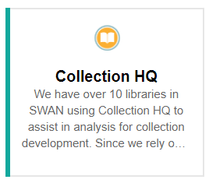
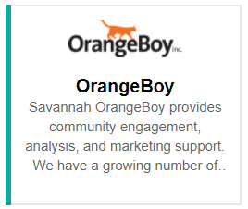
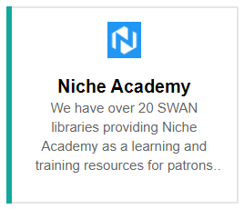
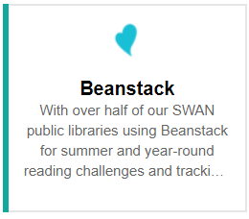
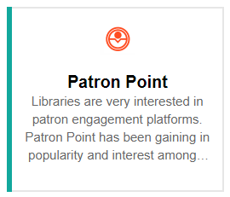

Are there other common 3rd party services and resources where library
sharing would be beneficial? If so, let us know and we will create -

Slide 21
SWAN Training & Learning Management System

Slide 22
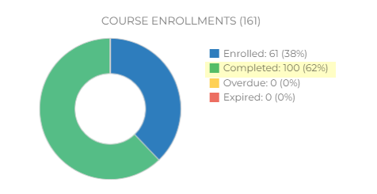
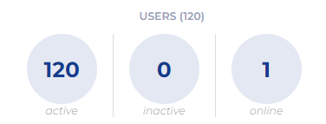
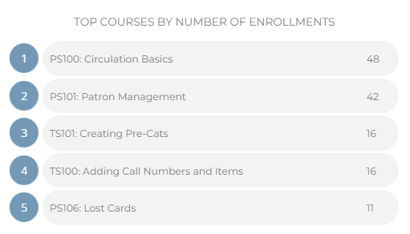
Surpassed 1st year projections in 5 months
Maintaining our high completion rate of 62%
Crystal Vela, Consultant, User Experience
  Subject Matter Expert: Patron Services
Claudia Nickson, Consultant, Bibliographic Services
  Subject Matter Expert: Technical Services

Slide 23
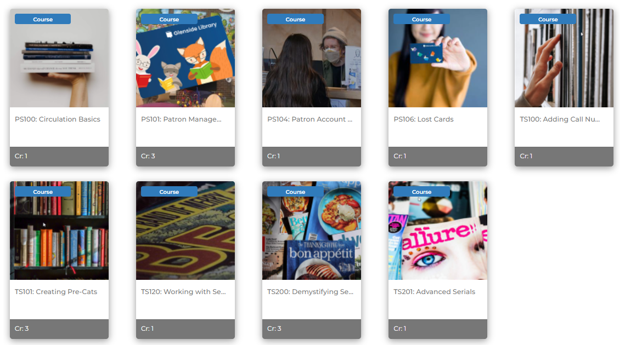
Course Catalog
PS100: Circulation Basics
PS101: Patron Management
PS104: Patron Account Blocks & Notes
PS106: Lost Cards
TS100: Adding Call Numbers & Items
TS101: Creating Pre-Cats
TS120: Working with Series
TS200: Demystifying Serials
TS201: Advanced Serials

Slide 24
SWAN Passport Idea
Libraries Empower Connections

Slide 25
Libraries Empower Connection
Request from member library to consider a SWAN-wide program in September.
Formed a brainstorming group to share ideas.
Purpose:
  highlight the resource sharing of our SWAN consortium
  encourage visiting local libraries
  promote library card sign-up month
  feature your library’s connection to community
Similar programs have been successful that might provide some ideas.
  Connecticut Libraries
  ATLAS geo-caching – running from June 6- August 6, 2022
  Pinnacle Library Road Trip 2019
Interest Survey - SWAN Consortium

Slide 26
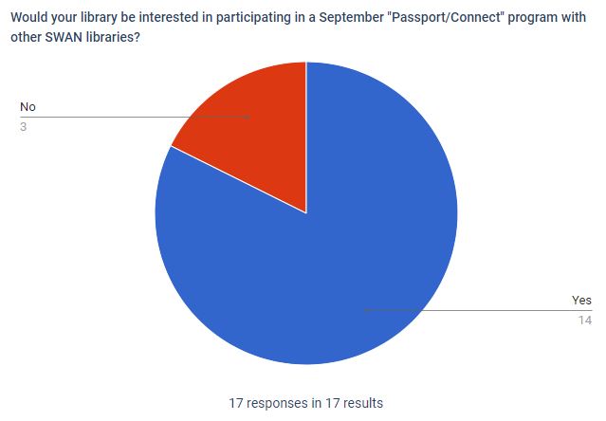
Survey results
Library
Bloomingdale Public Library
Downers Grove Public Library
Frankfort Public Library District
Glen Ellyn Public Library
Green Hills Public Library District
Kaneville Public Library District
LaGrange Public Library
Matteson Area Public Library District
Melrose Park Public Library
Midlothian Public Library
North Riverside Public Library District
South Holland Public Library
Thomas Ford Memorial Library
Town and Country Public Library District

Slide 27
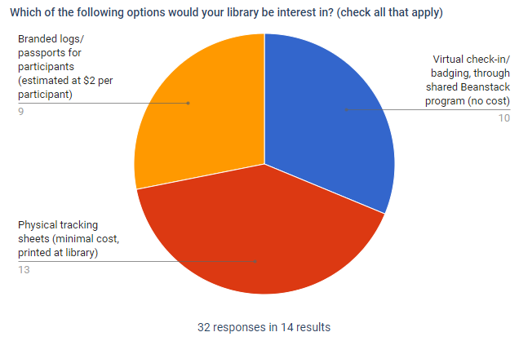

Slide 28
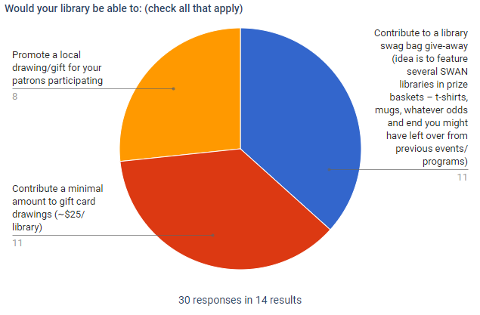

Slide 29
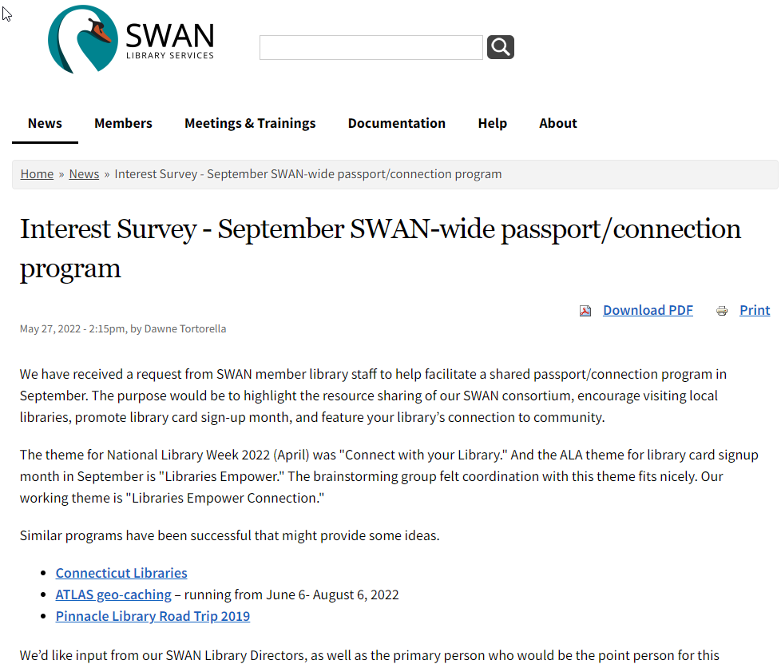
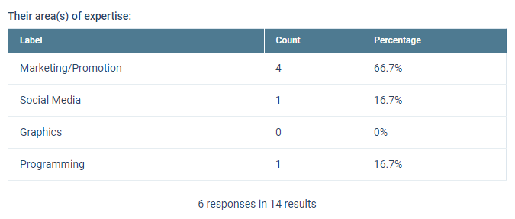

Slide 30
Announcements & Questions
Ted Bodewes, SWAN Board President
Thomas Ford Memorial Library, Western Springs, IL

